Slide 1
Session 6
jQuery and jQuery Mobile

Slide 2
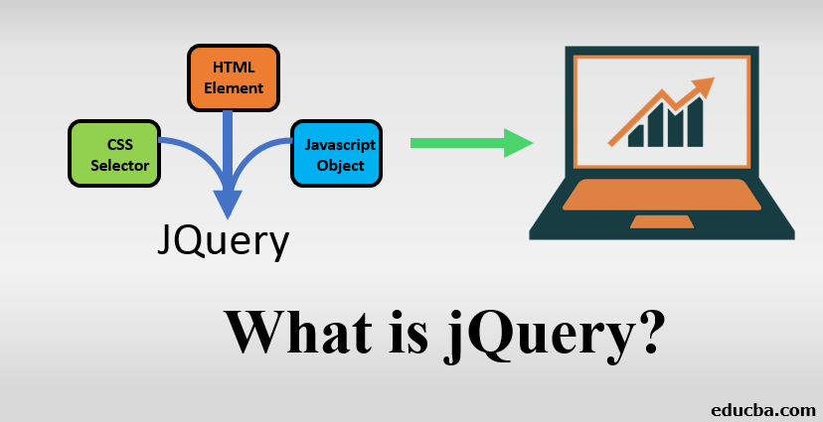
Introduction to jQuery
1. What is jQuery? - Introduction to jQuery as a JavaScript library. - Advantages of using jQuery for web development. 2. Getting Started with jQuery - Downloading and including jQuery in your project. - Using a Content Delivery Network (CDN) for faster loading. - Basic syntax and structure of jQuery code.

Slide 3
jQuery Selectors
1. Understanding Selectors - Introduction to selectors in jQuery. - Selecting elements based on IDs, classes, attributes, and more. 2. Basic Selectors - Using element selectors to target specific HTML elements. - Using class and ID selectors to target specific classes and IDs. 3. Combining Selectors - Combining multiple selectors to target specific elements. - Understanding descendant, child, and sibling selectors.

Slide 4
Events and Event Handling
1. Introduction to Events - Understanding events in web development. - Common types of events (click, submit, mouseover, etc.). 2. Event Handling with jQuery - Using the `.on()` method to attach event handlers. - Using anonymous functions and named functions for event handling. 3. Event Delegation - Understanding event delegation for dynamic content. - Handling events on elements that are added later.

Slide 5
DOM Manipulation with jQuery
1. Changing HTML Content - Using the `.html()` method to set or get HTML content. - Modifying text content using the `.text()` method. 2. Modifying CSS - Adding, removing, and toggling CSS classes. - Changing inline styles using the `.css()` method. 3. Manipulating Attributes and Properties - Changing attribute values using the `.attr()` method. - Manipulating properties like `value`, `checked`, etc.

Slide 6
Animations and Effects
1. Basic Animations - Using jQuery to create simple animations. - Animating properties like `height`, `width`, and `opacity`. 2. Chaining Animations - Chaining multiple animations for smoother effects. - Using the `.delay()` method to introduce delays. 3. Fading and Sliding - Using `.fadeIn()`, `.fadeOut()`, `.slideDown()`, and `.slideUp()` methods.

Slide 7
AJAX with jQuery
1. Introduction to AJAX - Understanding Asynchronous JavaScript and XML (AJAX). - The role of AJAX in loading data without page reloads. 2. Using `.ajax()` Method - Making HTTP requests using the `.ajax()` method. - Handling responses, success, and error scenarios. 3. Working with JSON Data - Fetching and parsing JSON data using AJAX. - Displaying JSON data on the webpage.

Slide 8
jQuery selector example
<!DOCTYPE html>
<html lang="en">
<head>
<meta charset="UTF-8">
<meta name="viewport" content="width=device-width, initial-scale=1.0">
<title>jQuery Selectors and Effects</title>
<script src="https://code.jquery.com/jquery-3.6.0.min.js"></script>
<style>
.hidden {
display: none;
}
</style>
</head>
<body>
<h1>jQuery Selectors and Effects</h1>
<button id="showContent">Show Content</button>
<button id="hideContent">Hide Content</button>
<button id="toggleContent">Toggle Content</button>
<div id="content" class="hidden">
<p>This is some hidden content.</p>
</div>
<ul>
<li class="item">Item 1</li>
<li class="item">Item 2</li>
<li class="item">Item 3</li>
</ul>
<script>
// Show, Hide, and Toggle Effects
$(document).ready(function() {
$('#showContent').click(function() {
$('#content').show();
});
$('#hideContent').click(function() {
$('#content').hide();
});
$('#toggleContent').click(function() {
$('#content').toggle();
});
// Basic Selectors
$('.item').click(function() {
$(this).toggleClass('selected');
});
});
</script>
</body>
</html>
We include the jQuery library using a CDN.
Show, Hide, and Toggle Effects:
When the "Show Content" button is clicked, the hidden content is displayed.
When the "Hide Content" button is clicked, the content is hidden.
When the "Toggle Content" button is clicked, the content visibility is toggled.
Basic Selectors:
When an <li> element with the class "item" is clicked, it toggles the "selected" class.

Slide 9
jQuery AJAX example
<!DOCTYPE html>
<html lang="en">
<head>
<meta charset="UTF-8">
<meta name="viewport" content="width=device-width, initial-scale=1.0">
<title>jQuery Example</title>
<script src="https://code.jquery.com/jquery-3.6.0.min.js"></script>
<style>
.selected {
background-color: yellow;
}
</style>
</head>
<body>
<h1>jQuery Example</h1>
<ul>
<li><a href="#">Item 1</a></li>
<li><a href="#">Item 2</a></li>
<li><a href="#">Item 3</a></li>
</ul>
<button id="changeText">Change Text</button>
<div id="content">Initial Content</div>
<h2>AJAX Example</h2>
<button id="loadData">Load Data</button>
<div id="dataContainer"></div>
<script>
// jQuery Selectors and Event Handling
$(document).ready(function() {
$('a').click(function(event) {
event.preventDefault();
$(this).addClass('selected').siblings().removeClass('selected');
});
$('#changeText').click(function() {
$('#content').text('New Content');
});
});
// AJAX Example
$('#loadData').click(function() {
$.ajax({
url: 'https://jsonplaceholder.typicode.com/posts/1',
method: 'GET',
success: function(data) {
$('#dataContainer').html('<strong>Title:</strong> ' + data.title + '<br><strong>Body:</strong> ' + data.body);
},
error: function() {
$('#dataContainer').text('Error loading data.');
}
});
});
</script>
</body>
</html>
In this example:
We include the jQuery library using a CDN.
jQuery Selectors and Event Handling:
When an anchor link is clicked, it gets the 'selected' class, and other links lose this class.
When the "Change Text" button is clicked, the content of the <div> with the ID "content" is changed.
AJAX Example:
When the "Load Data" button is clicked, an AJAX request is made to fetch data from a JSON API.
The retrieved data (title and body) is displayed in the "dataContainer" <div>.

Slide 10
Plugins and Additional Resources
1. Introduction to jQuery Plugins - Exploring the concept of jQuery plugins. - Examples of popular jQuery plugins for various functionalities. 2. jQuery UI and Mobile - Brief overview of jQuery UI for user interface components. - Introduction to jQuery Mobile for mobile web development. 3. Learning Resources - Recommended websites, tutorials, and documentation for further learning. - Community forums and resources for troubleshooting and help.

Slide 11
Practical Exercises and Projects
1. Creating Interactive Web Components - Build interactive elements like dropdown menus, accordions, and tabs. - Practice using selectors, events, and DOM manipulation. 2. Building an AJAX-powered Feature - Create a dynamic content loader using AJAX. - Fetch and display data from an external source. 3. Building a Simple Gallery with Animations - Construct a basic image gallery with animated transitions. - Apply jQuery animations for a visually appealing effect.

Slide 12
Introduction to jQuery Mobile
1. What is jQuery Mobile? - Introduction to jQuery Mobile as a mobile web framework. - Overview of its features and benefits for mobile app development. 2. Getting Started with jQuery Mobile - Downloading and including jQuery Mobile in your project. - Using a Content Delivery Network (CDN) for quicker loading. - Basic structure of a jQuery Mobile page.

Slide 13
Creating Mobile Pages
1. Page Structure and Layout - Understanding the structure of jQuery Mobile pages. - Using header, content, footer, and panel components. - Creating multi-page templates for navigation. 2. Navigation and Links - Using internal and external links in jQuery Mobile. - Creating navigation bars and toolbars for consistent UI. 3. Enhancing Buttons - Styling buttons for mobile-friendly interactions. - Creating buttons with icons and labels.

Slide 14
UI Components and Widgets
1. Lists and Forms - Creating responsive lists for mobile views. - Designing forms with various input types. 2. Collapsible Content - Using collapsible sets to display content dynamically. - Implementing accordions and expandable sections. 3. Popups and Dialogs - Creating popups and dialog boxes for user interactions. - Customizing the appearance and behavior of popups.

Slide 15
Responsive Design and Theming
1. Responsive Grid Layout - Utilizing the responsive grid system for layout design. - Ensuring content adapts to different screen sizes. 2. Theming and Styling - Exploring jQuery Mobile themes and styles. - Customizing themes for a unique app appearance.

Slide 16
Handling Touch Events
1. Touch and Swipe Events - Understanding touch events in jQuery Mobile. - Implementing swipe gestures and touch interactions. 2. Handling Gestures - Using built-in gesture events like swipe, tap, and pinch. - Creating custom gesture-based interactions.

Slide 17
Dynamic Content Loading
1. Loading Content with AJAX - Fetching and displaying remote content using AJAX. - Enhancing user experience with dynamic content loading. 2. Loading Pages and Transitions - Loading external pages using AJAX for smoother transitions. - Applying page transitions for a polished look.

Slide 18
Building Mobile Apps
1. App Structure and Architecture - Designing mobile app architecture using jQuery Mobile. - Organizing pages, components, and interactions. 2. Using PhoneGap/Cordova - Introduction to PhoneGap/Cordova for turning web apps into native mobile apps. - Building and deploying mobile apps using PhoneGap/Cordova.

Slide 19
Practical Exercises and Projects
1. Creating a Mobile Landing Page - Build a simple mobile landing page with header, content, and footer. - Include buttons, navigation, and basic UI components. 2. Building a Mobile Form - Construct a mobile-friendly form with validation and user feedback. - Use input types and custom styling for improved usability. 3. Developing a Mobile App Prototype - Design a multi-page mobile app prototype using jQuery Mobile. - Implement navigation, dynamic content, and responsive layout.

Slide 20
References
https://www.w3schools.com/jquery/jquery_examples.asp
https://amazingcarousel.com/examples/

